Slide 1
UHD Learn ++ Learning Management System
By: Andrew Truong, Daniel fabela, Eduardo rojas, hung ly, Sumanth pisipati

Slide 2
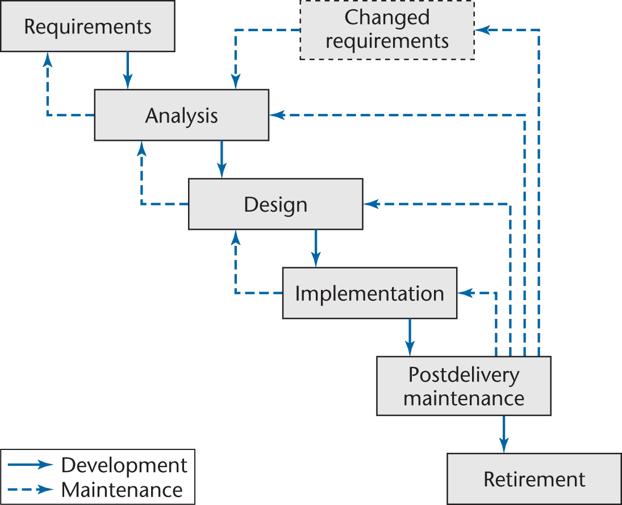
Life Cycle
Waterfall Model

Slide 3
Requirements
To build a student information management system.
The system tracks the details of the student: enrolled courses, progress, exam grades, etc
Instructors are administrators
Able to edit enrolled students grades, add courses taught, delete, etc.
Students are users
Able to view assignments, grades, enrolled courses, etc

Slide 4
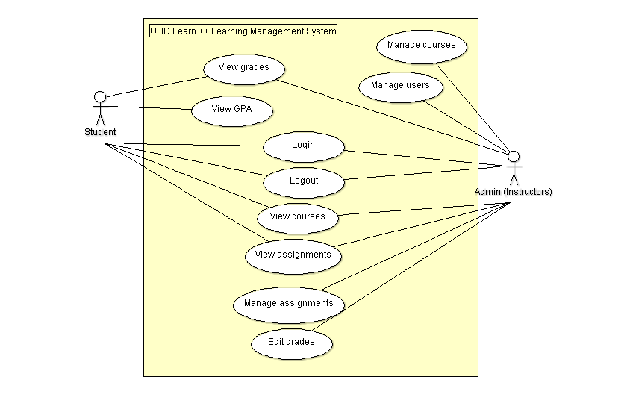
UML Use Case Diagrams

Slide 5
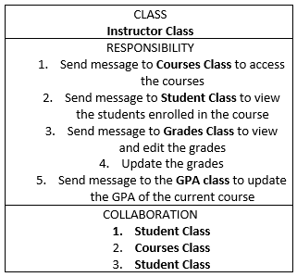
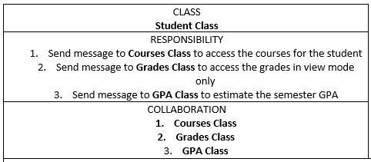
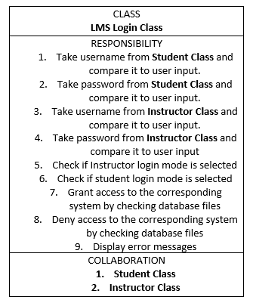
Analysis Workflow
CRC Cards

Slide 6
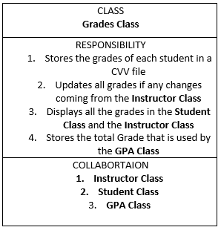
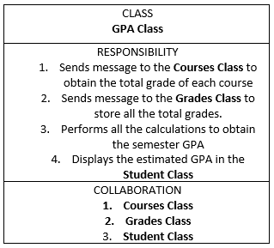
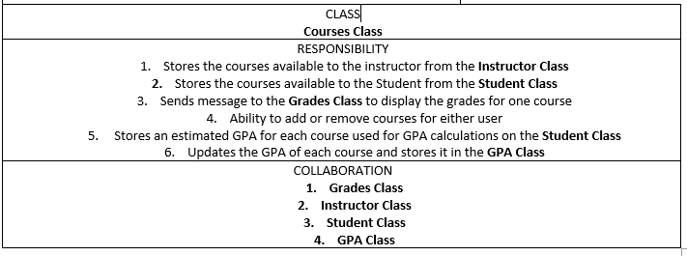
CRC Cards cont.

Slide 7
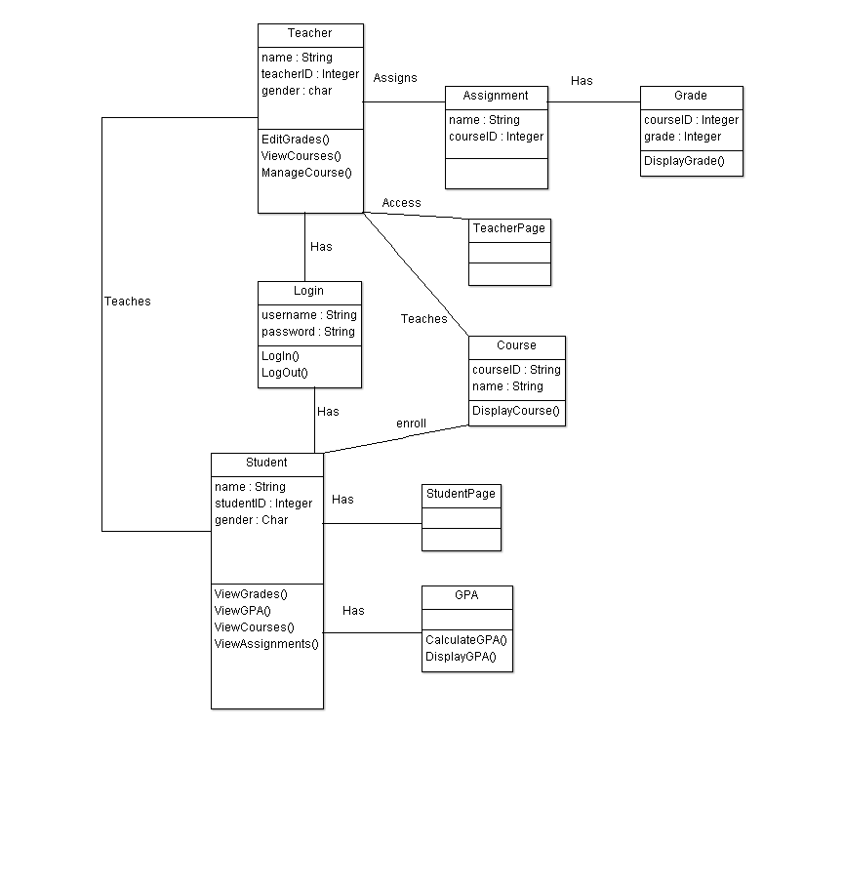
Class Diagram

Slide 8
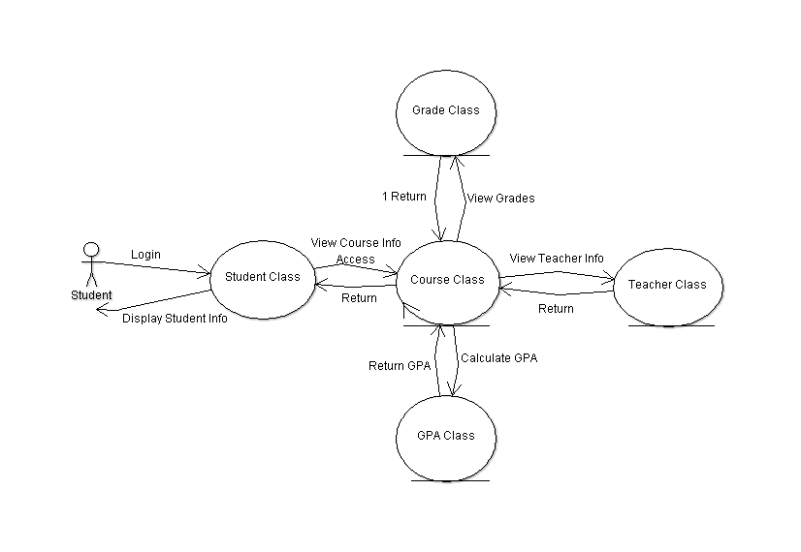
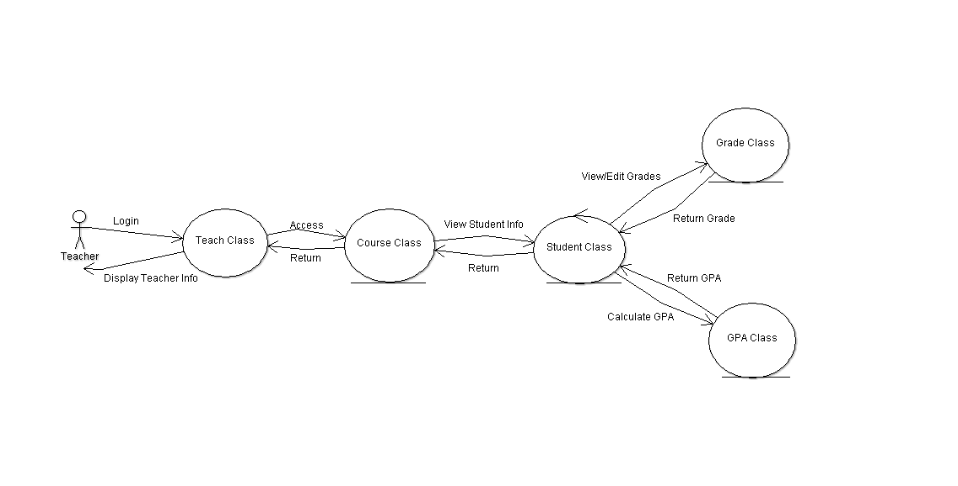
Collaboration Diagram

Slide 9
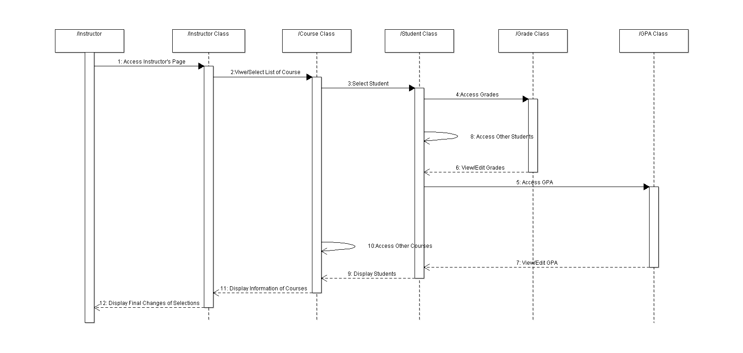
Sequence Diagram

Slide 10
Execution
Project coded in C# using Visual Studio Window Form Application
Used Microsoft SQL Server 2017 RDBMS for Database

